Slide 1
FMRI : a mind reader ?
Léa Nicolas, Enzo Yerly

Slide 2
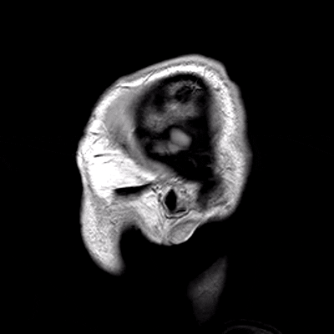
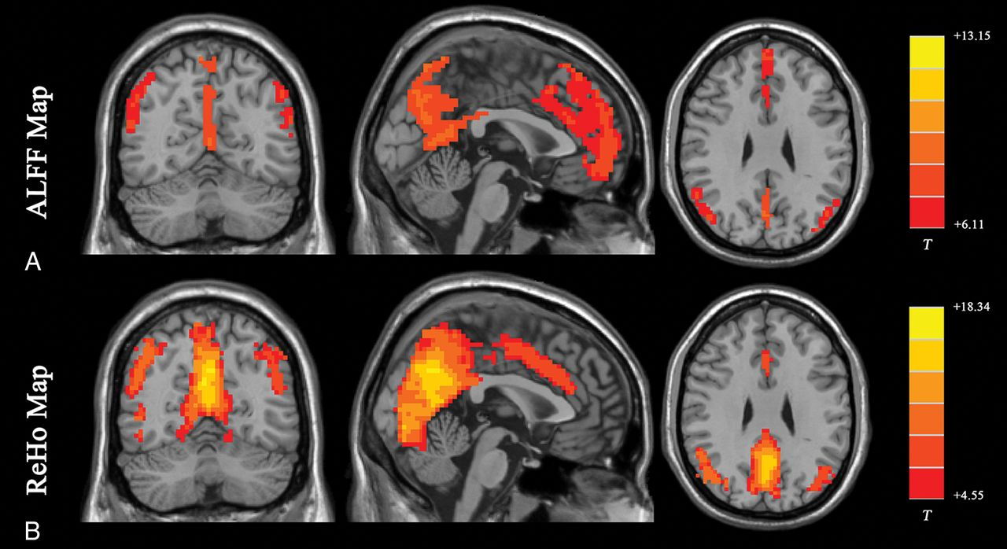
History of fMRI
MRI
fMRI
Resting-state functional MRI : Everything that nonexperts have always wanted to know (2018), H. Lf, Z. Wang et al
Clinical usage in the 1980s
Image of soft tissue
2D - 3D image
Notes:
The widespread of the mri usage in the 1980s has changed the way diagnostics are made. Allowing imaging of organs and physiological processes happening inside the body. It’s mostly used for soft tissues imaging (like the brain or the abdomen) and provides a 2D-3D image of what’s inside the body.
Later on was introduced fMRI (functional MRI), allowing to extend the usage of the MRI to record changes in the brain induced by neural activity.
fMRI record both spatial and temporal information about the brain
But how did we go from a image of the brain to knowing brain activity ? (à reformuler)
But how do we get these insights on brain activity as pictured on the right image ? (mieux ou bof ?)

Slide 3
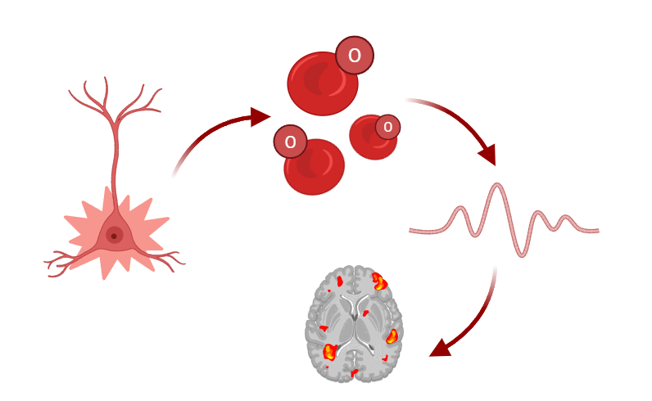
How does it work ?
Blood-oxygenation-level–dependent imaging (BOLD)
Release of oxygen
Change in magnetic signal
Neuron firing
Imaging
Notes:
fMRI uses Blood-oxygenation-level–dependent imaging (BOLD), which is an indirect measure of neural activity. It’s based on the fact that blood releases more oxygen for active neurons than for inactive ones.In 1990 Seiji Ogawa and his colleagues discovered that the oxygenated and deoxygenated forms of blood have different magnetic properties. Both of form can be detected using MRI.
In other words the change in the blood of actives neurons result in variations of the signal that the MRI get, hence we can detect which neurons are active and which are not.( hemodynamic response

Slide 4
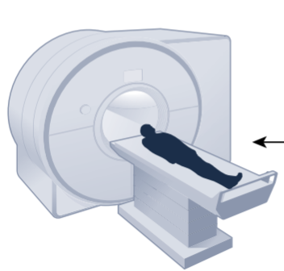
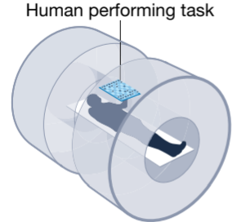
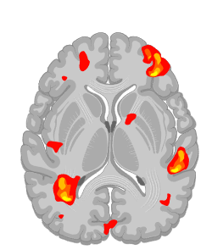
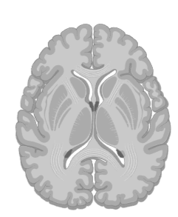
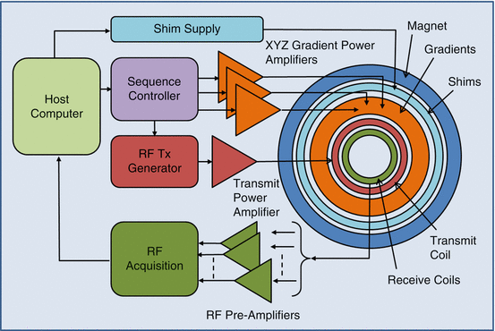
How does it work?
Human performing task
Compare with ‘resting state’
Functional neuroimaging as a catalyst for integrated neuroscience (2023), Emily S.Finn et al.
Non invasive
Whole brain access
MRI cutaway diagram
Glover, P. (2013). Magnetic Resonance Imaging (MRI) Methodology.
Notes:
The activity of the brain that we see on the scans are result of particular actions. The patient is asked to perform a task which will activate neurons, the signal will be compared to the ‘resting state’, which is in the absence of a particular task.
MRI basic functioning : you have a superconductor magnet (dark blue in scheme) rotating very fast that creates a magnetic field.
Microscopic changes in this magnetic field caused by nuclear magnetic resonance (quantic black magic) are recorded and give a contrast resolution pretty high.
Non-uniform magnetic fields are introduced by “gradients” (orange in scheme) are used to reconstruct 2D and 3D images of tissues (Lauterbur+Mansfield 2003 Nobel)

Slide 5
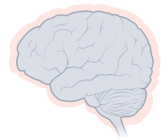
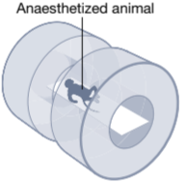
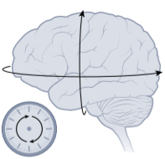
Advantages
Whole brain access
Non invasive
Cross-species use
Spatial and temporal
Very safe/ no radiation
Functional neuroimaging as a catalyst for integrated neuroscience (2023), Emily S.Finn et al.
Notes:
Useful for cross-species use, anesthesia might be a problem,
low temporal resolution of the fmri but for cross-species use spatial resolution is more important as it is more useful to know
if the same action fire neurons in the same part of the brain. Rather that knowing if it is firing at the same time (not very useful)
Useful in a lot of domains
Very safe -> no radiations

Slide 6
Comparative Advantages of fMRI
EEG : poor spatial resolution
MEG : spatial deformation
PET : invasive, low resolution
Intracranial EEG : invasive, limited coverage
Notes:
EEG : Electroencephalography
MEG : Magneto- (records magnetic fields)
PET : Positron emission tomography (injects radioactive product that will track glucose consumption via Fluorodeoxyglucose (FDG))
iEEG : you place electrodes directly on brain surface, so limited to neurosurgical cases too

Slide 7
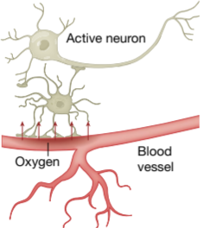
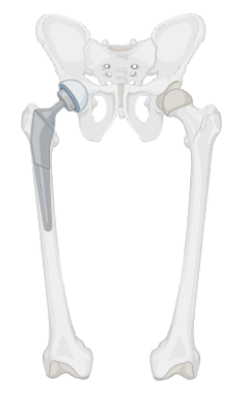
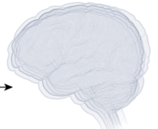
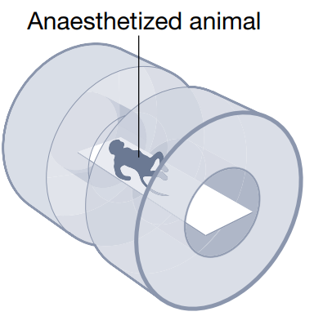
Limitations
Sensitive to noise
Indirect probe to neural connectivity
Slow response
Anesthesia constraints
Functional neuroimaging as a catalyst for integrated neuroscience (2023), Emily S.Finn et al.
No implant allowed
Notes:
The BOLD is an indirect probe to neural connectivity
BOLD response is relatively slow, spatial resolution is good but might be too small to distinguish small structures,
such as differentiating cell types or observing sub-cellular activity
Expensive and can’t be used on anyone (metal implant, physical constraints for elderly people)
Cross-species comparisons are hard because animals need to be anesthesiated

Slide 8
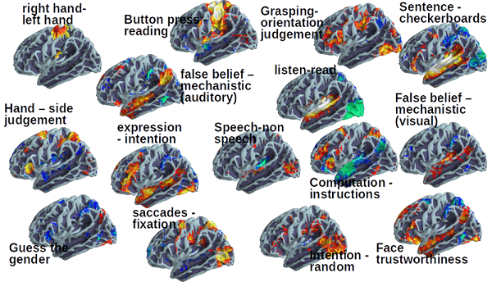
Reading Minds ? Kind of...?
Distinguish top-down and bottom-up processes (see vs think)
Insights on how we perceive, remember and make decisions
Individual Brain Charting: A high-resolution brain map of cognitive functions (2018), Human brain Project
Notes:
Well we have seen that it has some limitation, it cannot be performed on everyone but is still applicable for large percentage of the population. It’s weak temporal resolution might not be a problem depending on the task. And generally speaking the resolution as improved over the years. fMRI is currently one of the best tool to understand how the brain works, so what’s the issue with it ? How come we don’t know everything about the brain ?
The main issue of the fMRI is not likely to be resolved by better engineering, it mostly due to how the brain function
slide titles inspo :
"Reading Minds? Kind of..."
"So... Can It Really Read Minds?"
"Mind Reader: Science Fiction or Science Fact?"
"It Knows What You're Thinking—Almost"

Slide 9
The Reality Behind 'Mind Reading'
Not at the good scale (neuron vs brain)
Emergent properties still not well understood
Not really a technology issue, more of an approach issue
No guarantee if the mapping stays up-to-date
Notes:
“it makes no sense to read to read a newspaper with a microscope” Valentino Braintenberg
fMRI gives use informations about the brain function but it’s just the tip of the iceberg
To understand the brain one needs to be able to understand the complexity of the connections between each neurons as well as the functioning of large-scale system, such as the one responsible for our memory or linguistic capacities. We must know the architectural units of the brain, and the interconnections of such units.
Looking at individual neurons (if it was possible) firing may not be relevant for certain application.
Does the activation of an area mean that it is truly involved in the task at hand?

Slide 10
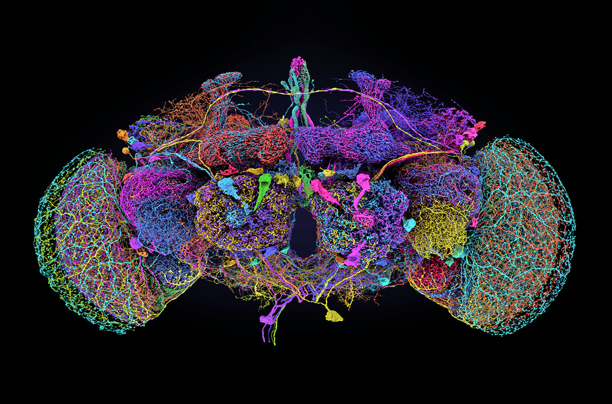
What's Next in Decoding the Brain?
fMRI still good to get overall regions
Connectome of fruit flies brain
(millions times more connexions in human)
Map regions to behaviors
Cross-check with other techniques (maybe more invasive)
FAFB connectome
Notes:
fMRI is a great tool, at this moment the best we have, it can to a certain extend know which region are responsible for a certain type of behavior. But using it alone is not sufficient to understand the brain. We need better understanding of the interactions between the different subunits of the brain. Coupling fMRI with other more invasive and specialized tools (such as iEEG) could help cross-checking informations or have new ones.
The fruit fly example is NOT done by fMRI but shows the current advancements we have
Don’t worry no one can read your mind yet ;)

Slide 11
Questions ?

